Slide 1
Project Presentation – CM2003 David Dashti Filip Söderquist

Slide 2
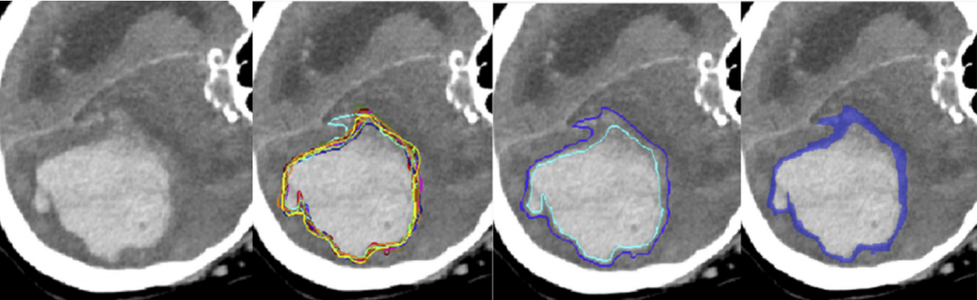
The challenge - QUBIQ
Quantification of Uncertainties in Biomedical Image Quantification Challenge

Slide 3
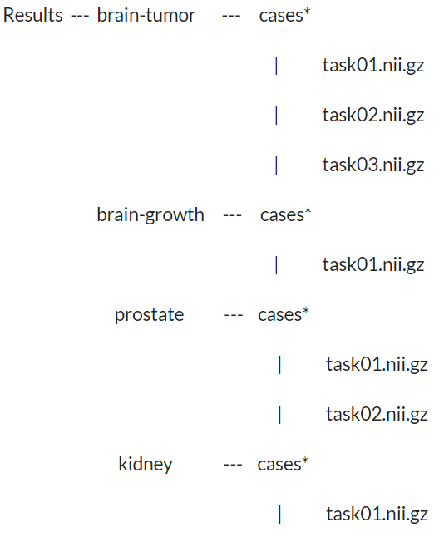
Data
( 3 masks / task )
( 7 masks )
( 6 masks / task )
( 3 masks )

Slide 4
Data split
Original Challenge
Adjusted Challenge
Data | Train. | Val. | Test
Tumor | 28 | 4 | 8
Growth | 34 | 5 | 10
Prostate | 48 | 7 | 13
Kidney | 20 | 4 | 4
Data | Train. | Val. | Test
Tumor | 24 | 4 | 4
Growth | 29 | 5 | 5
Prostate | 41 | 7 | 7
Kidney | 16 | 4 | 4
Split: 70 / 10 / 20
Split: 75 / 12.5 / 12.5

Slide 5
The task in detail
Task
Segment the given binary structures and predict the distribution of the experts' labels by returning one mask with continuous values in between 0 and 1, that is supposed to reproduce the cumulated segmentations of the experts. Predictions and continuous ground truth labels are compared by thresholding the continuous labels at predefined thresholds and calculating the volumetric overlap of the resulting binary volumes using Dice score (the continuous ground truth labels are obtained by averaging multiple experts' annotations). To this end, ground truth and prediction are binarized at ten probability levels (that are 0.1, 0.2, ..., 0.8, 0.9). Dice scores for all thresholds will be averaged. Dice scores will be averaged across all tasks and all image data sets.

Slide 6
How we approached this problem
Predictions
We trained one network for each expert. I.e. for brain-growth we trained 7 networks as we had 7 expert segmentations for each image.
Then we averaged the predictions of these networks. Thus, creating a continuous mask.
After that we binarized this continuous mask at the 9 chosen threshold levels (0.1, 0.2, …, 1.0), producing 9 binarized masks.
These 9 binarized masks were then compared to the expert masks
The expert masks
In order to be able be able to do the comparison we had to do two steps
Averaging of all the expert masks to create a continuous mask.
This continuous mask was then binarized into 9 different masks which we then made comparisons with.

Slide 7
The different architectures
The core of our architecture is that we are using an ensemble of networks to create the continuous prediction mask
Architecture of the networks within the ensemble
We used U-Net & Data Augmentation as a starting point
Dropout / Spatial Dropout
LSTM
Deep U - Net

Slide 8
Results

Slide 9
Evaluation

Slide 10
Thank you for listening! Questions?
Discussion

